Slide 1

Hotel Reservation Management System
G.Keerthi Harshana:25B11CS269
T.Radhika:25B11CS945
T.Lakshmi Sowjanya:26B21CS070
R.Pavithra:25B11CS804

Slide 2

Introduction
A hotel reservation management system helps customers book rooms easily and efficiently.
It allows users to check room availability and select suitable rooms.
The system stores customer and reservation details securely.
It reduces manual work and minimizes booking errors.
It provides an organized way to manage bookings, cancellations, and customer information.

Slide 3
Problem Statement
Manual hotel bookings are time-consuming and error-prone.
Checking room availability manually is difficult.
Managing customer and booking details can be inefficient.
Booking conflicts may occur due to poor record management.
A computerized system is needed to manage reservations efficiently.
The Hotel Reservation Management System is developed to overcome these problems by storing and managing hotel-related information in a centralized MySQL database.
The system helps manage customer details, hotel information, room details, reservations, payments, and staff information efficiently.

Slide 4
Objectives
The main objectives of the Hotel Reservation Management System are:
To manage customer information efficiently.
To manage hotel and room details.
To check room availability quickly.
To create, update, and cancel room reservations.
To maintain payment information.
To reduce manual work and paperwork.
To minimize errors and duplicate bookings.
To maintain accurate and consistent records.
To provide quick access to customer, room, and reservation information.
To improve the overall efficiency of hotel management.

Slide 5
Functional Requirements
User registration and login.
Search available rooms by date and type.
View room details, price, and availability.
Make and confirm room reservations.
Modify or cancel reservations.
Store and manage customer information.
Calculate booking cost and generate bills.
Process payment details securely.
Send booking confirmation and notifications.
Admin can manage rooms, bookings, and customers.

Slide 6
Non-Functional Requirements
System should be easy to use.
System should provide fast response time.
System should ensure data security.
System should be reliable and available.
System should support multiple users.
System should maintain data accuracy.
System should be easy to maintain.
System should be scalable for future needs.
System should provide secure user authentication.
System should have minimal system downtime.

Slide 7
End Users Of The System
Customer/Guest – Searches for rooms, checks availability, makes reservations, and cancels bookings.
Receptionist – Manages customer check-in, check-out, and reservations.
Hotel Manager – Monitors rooms, bookings, customers, and hotel operations.
Administrator – Manages users, rooms, hotel details, and system records.

Slide 8
Attributes And Entities
1. Customer Customer_ID Name Phone Email Address
2. Room Room_ID Room_Number Room_Type Price Status
3. Reservation Reservation_ID Customer_ID Room_ID Check_In_Date Check_Out_Date Booking_Status
4. Staff Staff_ID Staff_Name Phone Role Salary
5. Hotel Hotel_ID Hotel_Name Location Phone Email
6. Payment Payment_ID Reservation_ID Payment_Date Amount Payment_Method Payment_Status

Slide 9
Hotel Reservation Management System
REVIEW 2
G.Keerthi Harshana:25B11CS269
T.Radhika:25B11CS945
T.Lakshmi Sowjanya:26B21CS070
R.Pavithra:25B11CS804

Slide 10
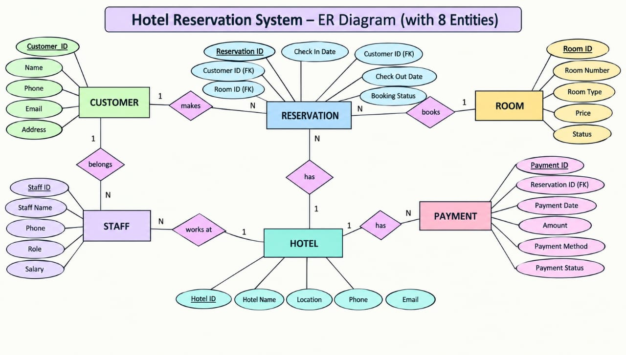

Slide 11
1. Your ER diagram
8 Entities:
CUSTOMER
ROOM
RESERVATION
STAFF
HOTEL
PAYMENT
BOOKING
REVIEW

Slide 12
SQL Creation
1.Hotel Table 2.Customer Table
CREATE TABLE HOTEL (
Hotel_ID NUMBER PRIMARY KEY,
Hotel_Name VARCHAR2(50) NOT NULL,
Location VARCHAR2(50) NOT NULL,
Phone VARCHAR2(15) UNIQUE,
Email VARCHAR2(60) UNIQUE
);
CREATE TABLE CUSTOMER (
Customer_ID NUMBER PRIMARY KEY,
Name VARCHAR2(50) NOT NULL,
Phone VARCHAR2(15) UNIQUE,
Email VARCHAR2(60) UNIQUE,
Address VARCHAR2(100)
);

Slide 13
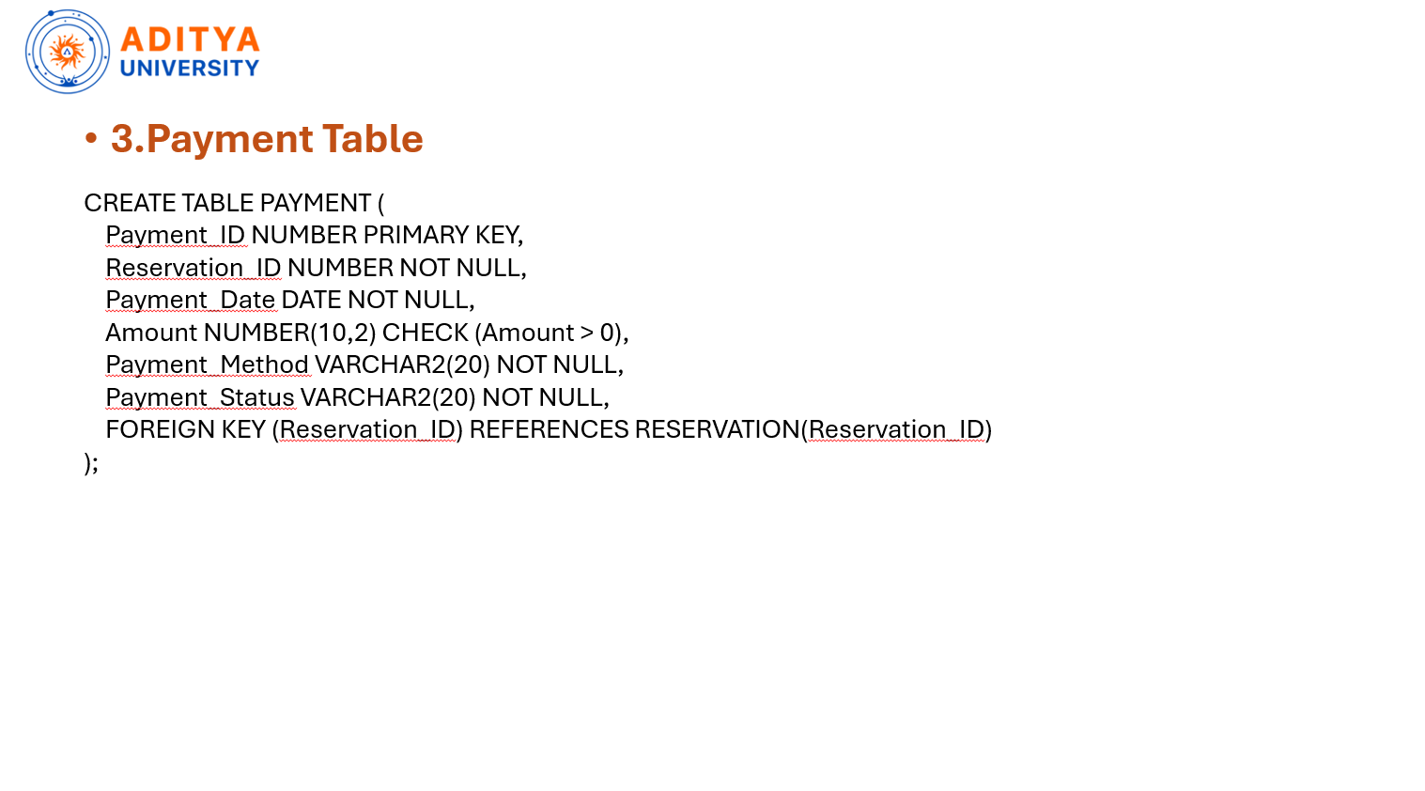

Slide 14
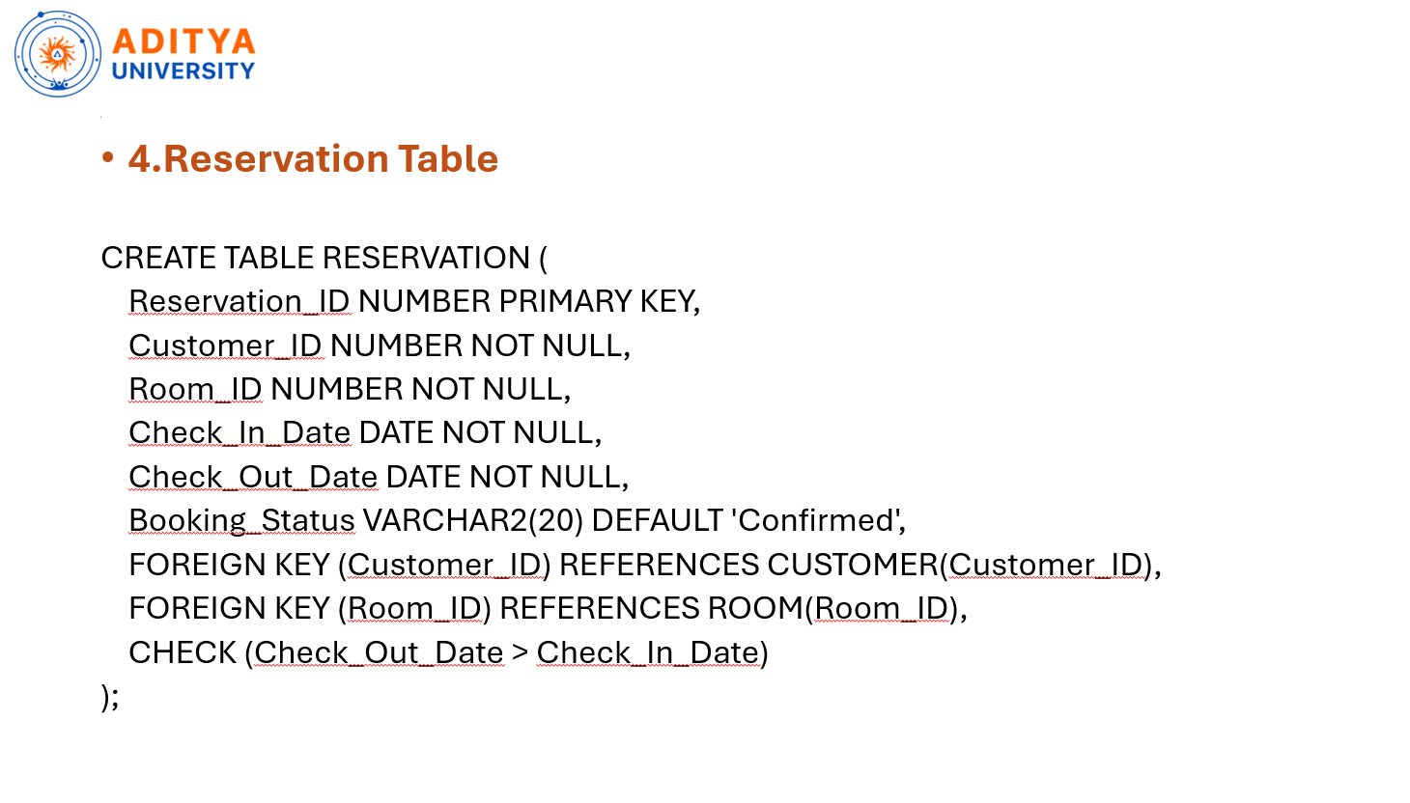

Slide 15
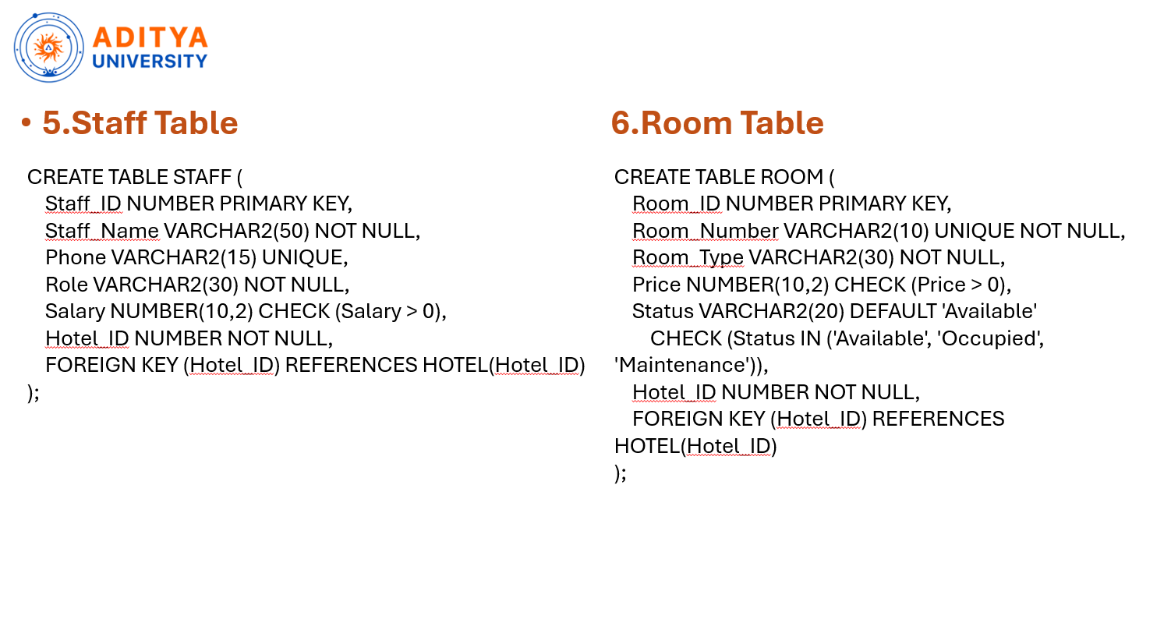

Slide 16
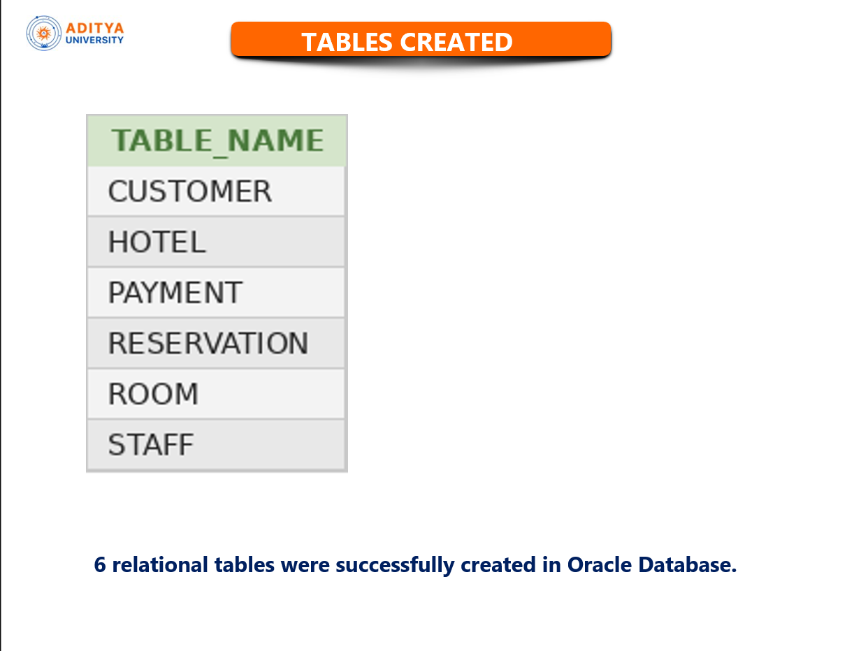

Slide 17
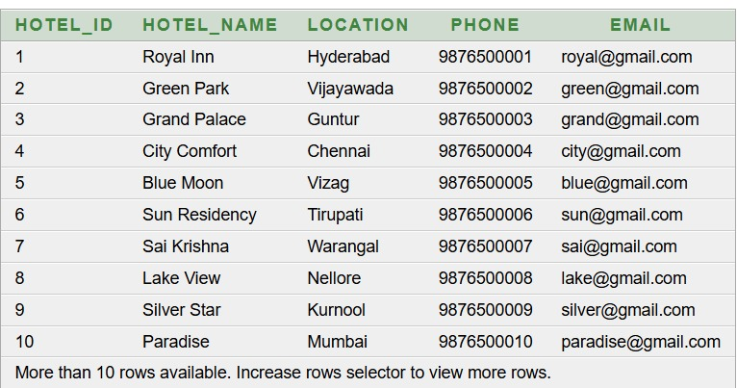
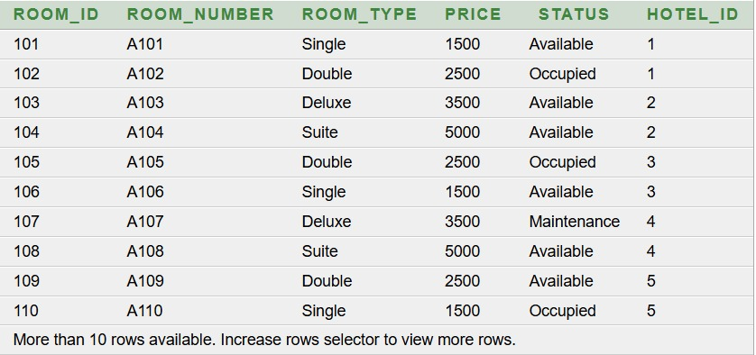
Sample Records
Hotel Table Room Table
SQL>SELECT * FROM HOTEL; SQL>SELECT * FROM ROOM;

Slide 18
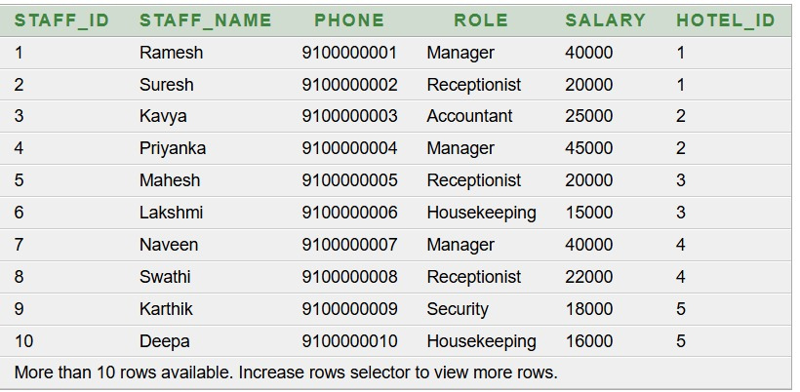
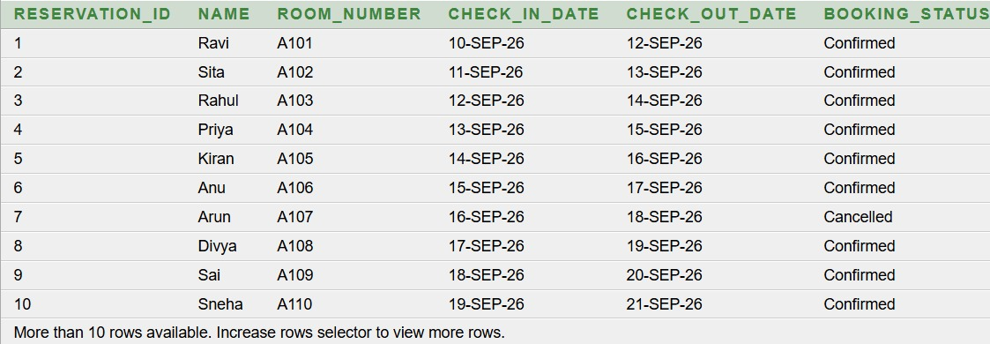
.
Staff Table Reservation Table
SQL>SELECT * FROM STAFF SQL>SELECT * FROM RESERVATION

Slide 19
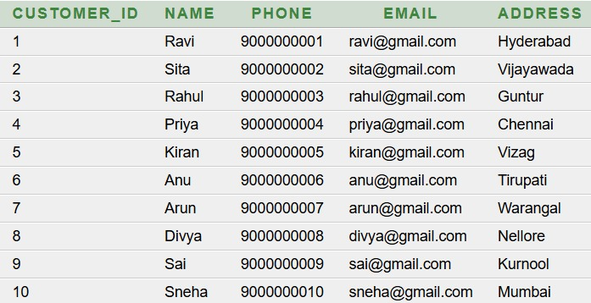
.
Customer Table
SQL>SELECT * FROM CUSTOMER

Slide 20
Basic Queries and Outputs
Q1. Display all customer details
SELECT * FROM CUSTOMER;
Output:

Slide 21
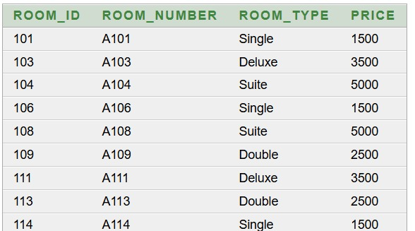
.
Q2. Display all available rooms
SELECT Room_ID, Room_Number, Output:
Room_Type, Price
FROM ROOM
WHERE Status = 'Available';

Slide 22
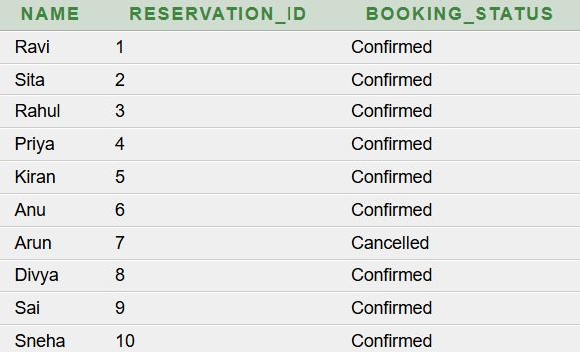
.
Q3. Display customer names and reservation status
SELECT c.Name,
r.Reservation_ID,
r.Booking_Status
FROM CUSTOMER c
JOIN RESERVATION r
ON c.Customer_ID = r.Customer_ID;
Output:

Slide 23
.
Q4. Display reservation details with customer and room information
SELECT r.Reservation_ID,
c.Name,
rm.Room_Number,
r.Check_In_Date,
r.Check_Out_Date,
r.Booking_Status
FROM RESERVATION r
JOIN CUSTOMER c
ON r.Customer_ID = c.Customer_ID
JOIN ROOM rm
ON r.Room_ID = rm.Room_ID;
Output:

Slide 24

.
Q5. Find the total paid amount
SELECT SUM(Amount) AS Total_Paid
FROM PAYMENT
WHERE Payment_Status = 'Paid';
Output:

Slide 25
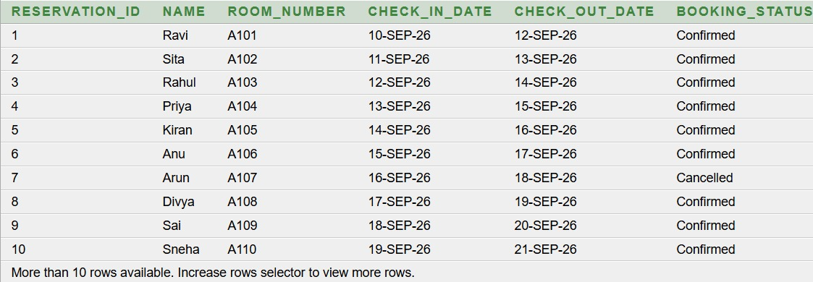
.
Q6. Display hotel names and staff working in them
SELECT h.Hotel_Name,
s.Staff_Name,
s.Role
FROM HOTEL h
JOIN STAFF s
ON h.Hotel_ID = s.Hotel_ID;
Output:

Slide 26
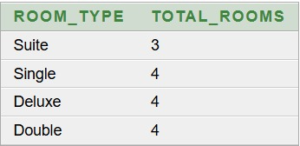
.
Q7. Count rooms by room type
SELECT Room_Type,
COUNT(*) AS Total_Rooms
FROM ROOM
GROUP BY Room_Type;
Output:

Slide 27
Normalisation
1NF – First Normal Form
Contains atomic (single) values
Avoids repeating groups
Each record has a unique primary key
2NF – Second Normal Form
Must already satisfy 1NF
Eliminates partial dependency
Every attribute depends on the entire primary key
3NF – Third Normal Form
Must already satisfy 2NF
Eliminates transitive dependency
Non-key attributes should depend only on the primary key

Slide 28

.
FIRST NORMAL FORM
1NF — BEFORE
Reservation_ID | Customer_ID | Room_ID | Status
R101 | C101 | RM01 | Confirmed
R102 | C102 | RM02 | Confirmed
R103 | C103 | RM03 | Confirmed
R104 | C104 | RM04 | Cancelled
R105 | C105 | RM05 | Confirmed

Slide 29
.
AFTER — 1NF
Customer_ID | Name | Phone
C101 | Ravi | 9876543210
C102 | Priya | 9876543211
C103 | Kiran | 9876543212
C104 | Anu | 9876543213
C105 | Rahul | 9876543214

Slide 30
.
Second Normal Form
2NF — BEFORE
Reservation_ID | Room_ID | Room_Type
R101 | RM01 | Single
R102 | RM02 | Double
R103 | RM03 | Deluxe
R104 | RM04 | Single
R105 | RM05 | Double
PK = (Reservation_ID, Room_ID)
Room type depends only on Room_ID, so partial dependency exists.

Slide 31
.
AFTER — 2NF
Reservation_ID | Customer_ID | Room_ID
R101 | C101 | RM01
R102 | C102 | RM02
R103 | C103 | RM03
R104 | C104 | RM04
R105 | C105 | RM05
Room_ID | Room_Number | Room_Type
RM01 | 101 | Single
RM02 | 102 | Double
RM03 | 103 | Deluxe
RM04 | 104 | Single
RM05 | 105 | Double
Partial dependency is eliminated.

Slide 32
.
Third Normal Form
3NF — BEFORE
RESERVATION
Reservation_ID | Customer_ID | Customer_Name | Room_ID | Room_Number
R101 | C101 | Ravi | RM01 | 101
R102 | C102 | Priya | RM02 | 102
R103 | C103 | Kiran | RM03 | 103
R104 | C104 | Anu | RM04 | 104
R105 | C105 | Rahul | RM05 | 105
Reservation_ID → Customer_ID → Customer_Name
Reservation_ID → Room_ID → Room_Number
Transitive dependency exists.

Slide 33
.
AFTER — 3NF
RESERVATION
CUSTOMER
Reservation_ID | Customer_ID | Room_ID
R101 | C101 | RM01
R102 | C102 | RM02
R103 | C103 | RM03
R104 | C104 | RM04
R105 | C105 | RM05
Customer_ID | Name | Phone
C101 | Ravi | 9876543210
C102 | Priya | 9876543211
C103 | Kiran | 9876543212
C104 | Anu | 9876543213
C105 | Rahul | 9876543214

Slide 34
Conclusion
The Hotel Reservation Management System database was successfully designed.
Required entities, attributes, and relationships were identified.
Tables were created using primary keys, foreign keys, and constraints.
Sample records were inserted and verified using SQL queries.
Basic SQL queries were executed to retrieve useful information.
Database normalization was studied up to 3NF.
Normalization helps reduce data redundancy and maintain data consistency.
The system provides an organized database structure for customers, hotels, rooms, reservations, payments, and staff.

Slide 35
Thank You

